Slide 1
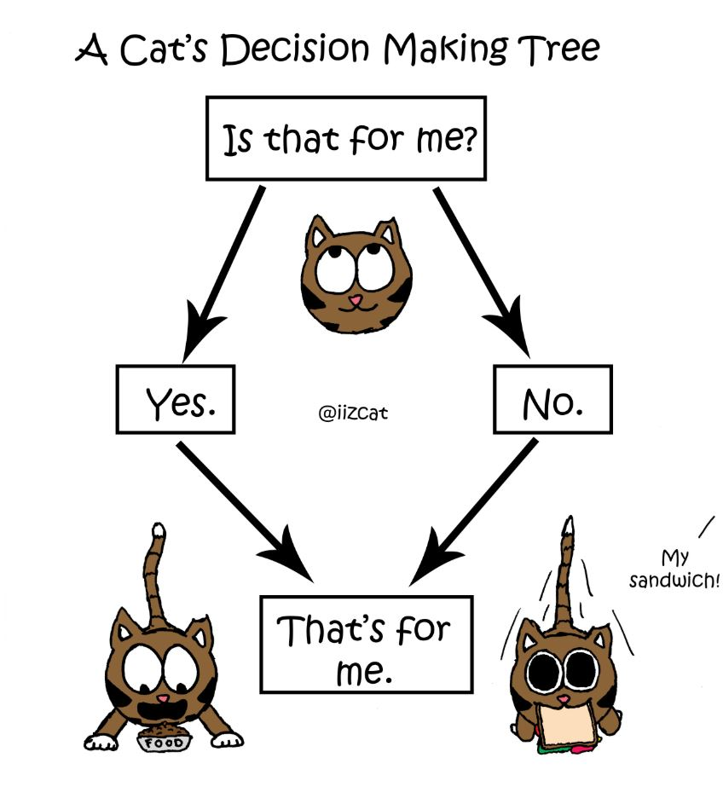
CSE 445: Machine Learning
Decision Trees
Instructor: Syed Athar Bin Amir, North South University

Slide 2
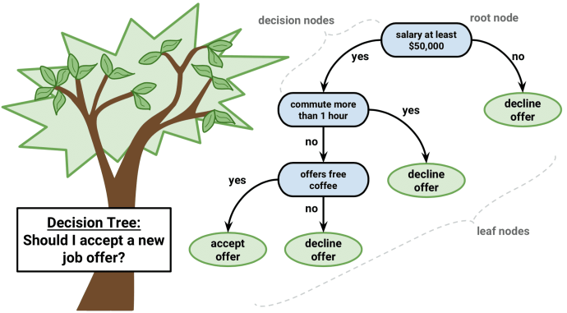
Decision Trees: Example
Notes:
https://dataaspirant.com/how-decision-tree-algorithm-works/

Slide 3
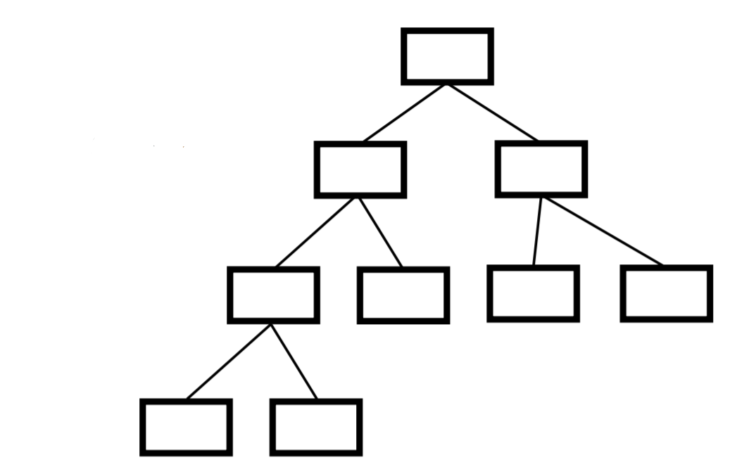
Decision Trees: Generic Structure
A Decision Tree is a flow-chart-like tree structure
Internal nodes: test an attribute
Branches: test result
Leaf nodes: Class label
At each node, one feature is picked to split training examples into distinct classes
New samples are classified by following a matching path to a leaf node

Slide 4
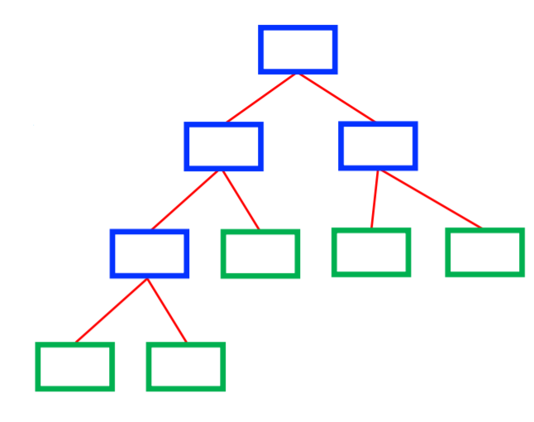
Decision Trees: Generic Structure
Goal: Predict Class label
Internal nodes: test an attribute
Branches: test result
Leaf nodes: Class label
How to build(i.e. train) Decision Trees? Two major methods are CART or ID3
CART → Classification and Regression Trees, Gini index used for best attribute
ID3 →Iterative Dichotomiser 3, Entropy used for best attribute

Slide 5
How to learn a Decision Tree
Greedy approach (NP complete problem)
Function BuildTree(m,A) //m:instances, A: attributes
if empty(A) or all m(L) are the same
status = leaf
class = most common class in m(L)
else
status = internal
a ← bestAttribute(m,A)
LeftNode = BuildTree(m(a=1), A \ {a})
RightNode = BuildTree(m(a=0), A \ {a})
end
end

Slide 6
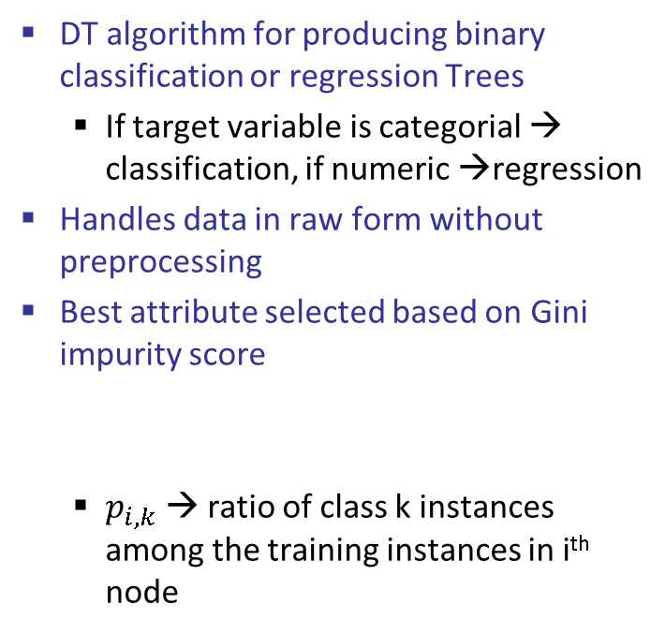

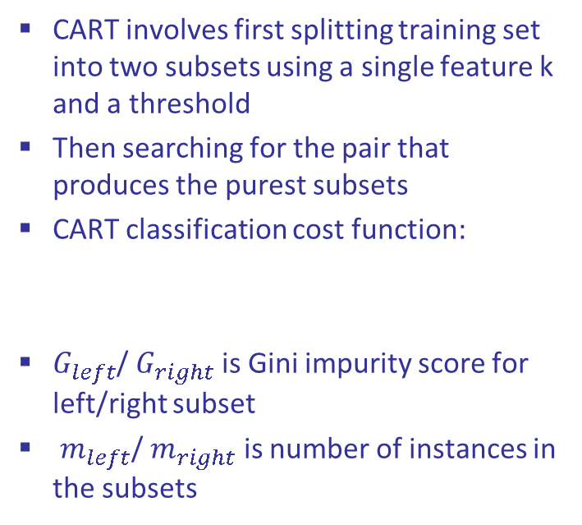

CART
DT algorithm for producing binary classification or regression Trees
If target variable is categorial → classification, if numeric →regression
Handles data in raw form without preprocessing
Best attribute selected based on Gini impurity score
$p_{i,k}$ → ratio of class k instances among the training instances in i^{th} node
CART involves first splitting training set into two subsets using a single feature k and a threshold
Then searching for the pair that produces the purest subsets
CART classification cost function:
$G_{left}$/ $G_{right}$ is Gini impurity score for left/right subset
$m_{left}$/ $m_{right}$ is number of instances in the subsets
$$J\left(k,t_{k}\right)=\frac{m_{left}}{m}G_{left}+\frac{m_{right}}{m}G_{right}$$
$$G_{i}=1−\sum_{k=1}^{n}{{\left(p_{i,k}\right)}^{2}}$$

Slide 7
CART Example
Example problem: Predict if a person has heart disease or not based on three features using a DT
Chest Pain | Good Blood Circulation | Blocked Arteries | Heart Disease
NO | NO | NO | NO
YES | YES | YES | YES
YES | YES | NO | NO
...
Sample dataset header
Notes:
https://towardsdatascience.com/decision-trees-a-step-by-step-approach-to-building-dts-58f8a3e82596

Slide 8
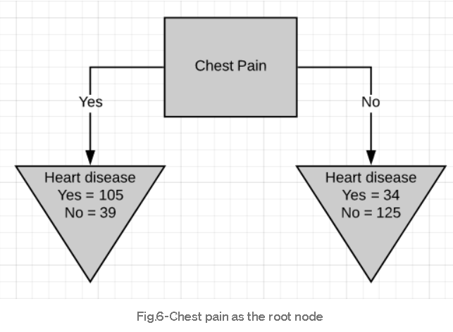
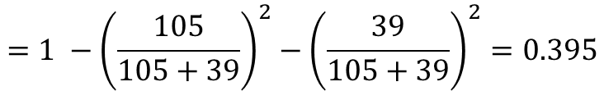
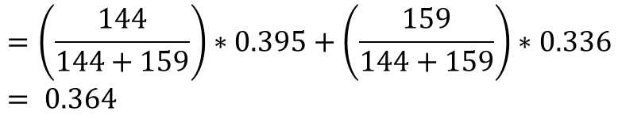
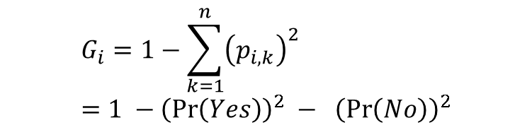
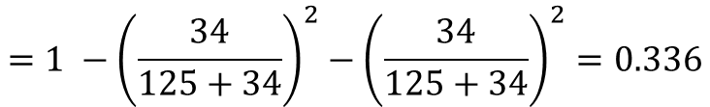
Attribute #1 : Chest Pain
Left leaf Gini impurity
$$=1 −{\left(\frac{105}{105+39}\right)}^{2}−{\left(\frac{39}{105+39}\right)}^{2}=0.395$$
Right leaf Gini impurity
$$=1 −{\left(\frac{34}{125+34}\right)}^{2}−{\left(\frac{34}{125+34}\right)}^{2}=0.336$$
Total Gini impurity – weighted average
$$=\left(\frac{144}{144+159}\right)∗0.395+\left(\frac{159}{144+159}\right)∗0.336 \\ = 0.364$$
$$G_{i}=1−\sum_{k=1}^{n}{{\left(p_{i,k}\right)}^{2}} \\ =1 −{\left(\operatorname{Pr}\left(Yes\right)\right)}^{2} − {\left(\operatorname{Pr}\left(No\right)\right)}^{2}$$

Slide 9
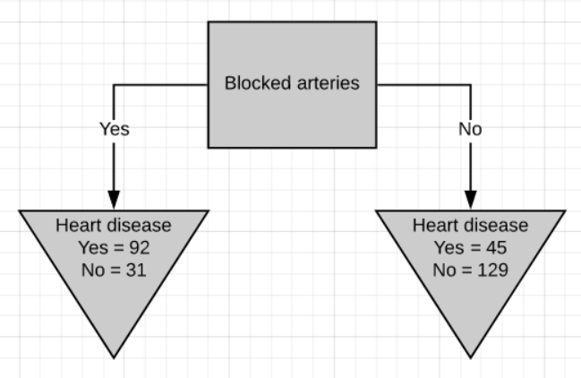
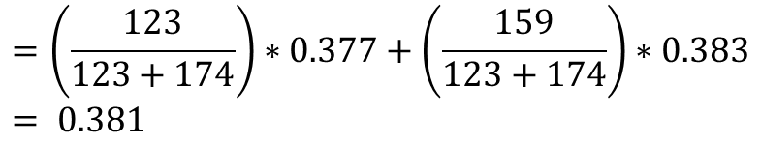
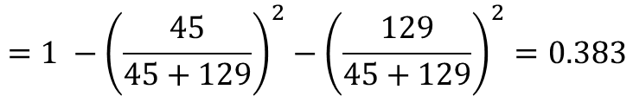
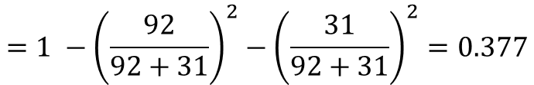
Attribute #2 : Blocked Arteries
Left leaf Gini impurity
$$=1 −{\left(\frac{92}{92+31}\right)}^{2}−{\left(\frac{31}{92+31}\right)}^{2}=0.377$$
Right leaf Gini impurity
$$=1 −{\left(\frac{45}{45+129}\right)}^{2}−{\left(\frac{129}{45+129}\right)}^{2}=0.383$$
Total Gini impurity – weighted average
$$=\left(\frac{123}{123+174}\right)∗0.377+\left(\frac{159}{123+174}\right)∗0.383 \\ = 0.381$$
Notes:
0.381 total weighted ave

Slide 10
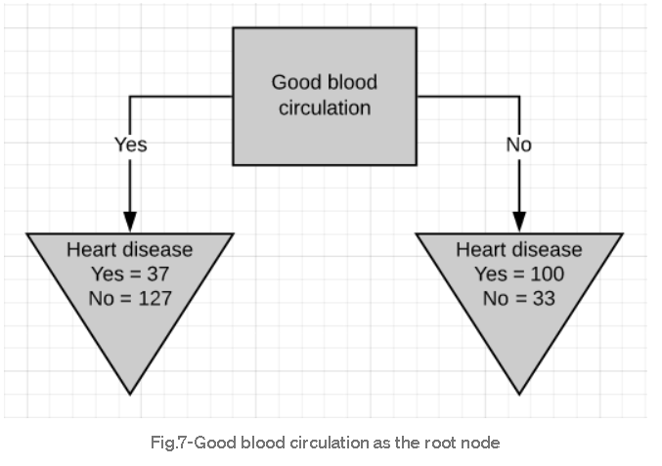
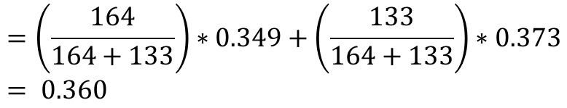
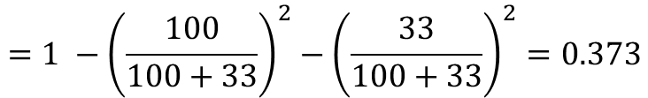
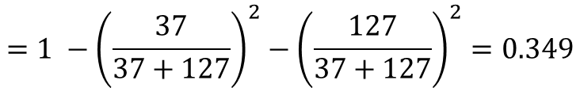
Attribute #3: Good Blood Circulation
Left leaf Gini impurity
$$=1 −{\left(\frac{37}{37+127}\right)}^{2}−{\left(\frac{127}{37+127}\right)}^{2}=0.349$$
Right leaf Gini impurity
$$=1 −{\left(\frac{100}{100+33}\right)}^{2}−{\left(\frac{33}{100+33}\right)}^{2}=0.373$$
Total Gini impurity – weighted average
$$=\left(\frac{164}{164+133}\right)∗0.349+\left(\frac{133}{164+133}\right)∗0.373 \\ = 0.360$$
Lowest impurity with this attribute – set as root node
Notes:
0.360 total weighted ave

Slide 11
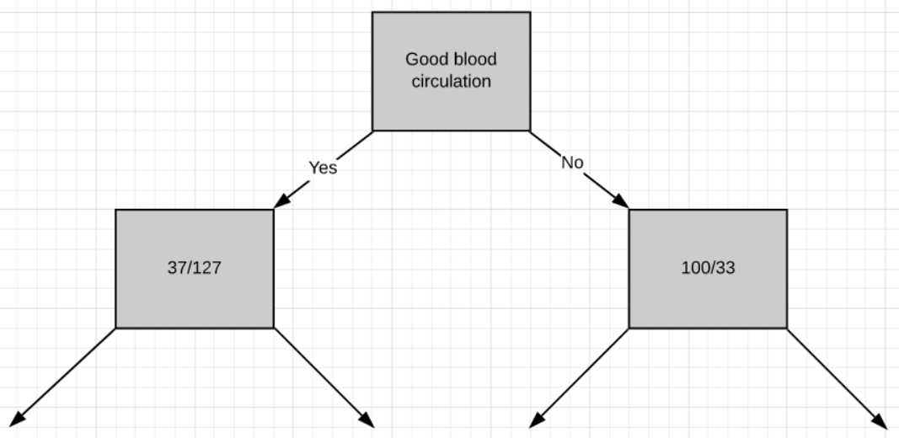
CART example
Selecting GBC as root node divides the tree as follows
Follow the same steps for the remaining internal nodes to find the decision tree

Slide 12
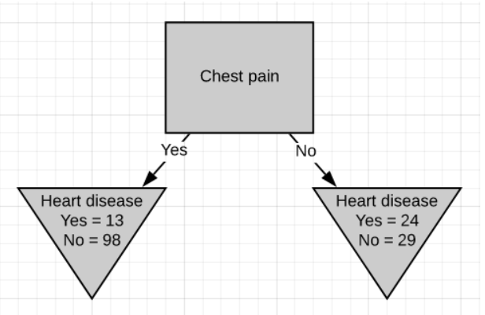
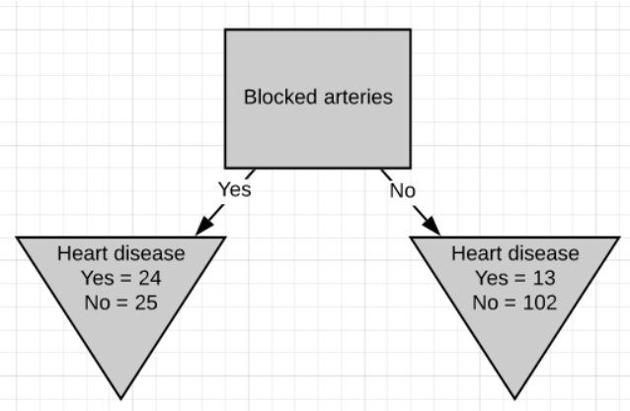
CART example

Slide 13
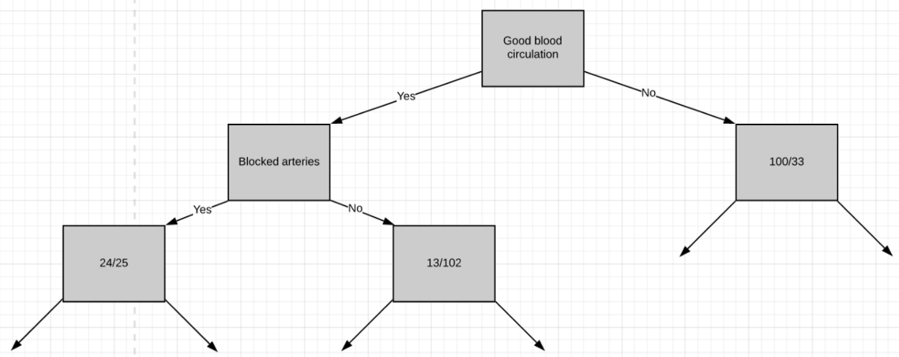
CART example

Slide 14
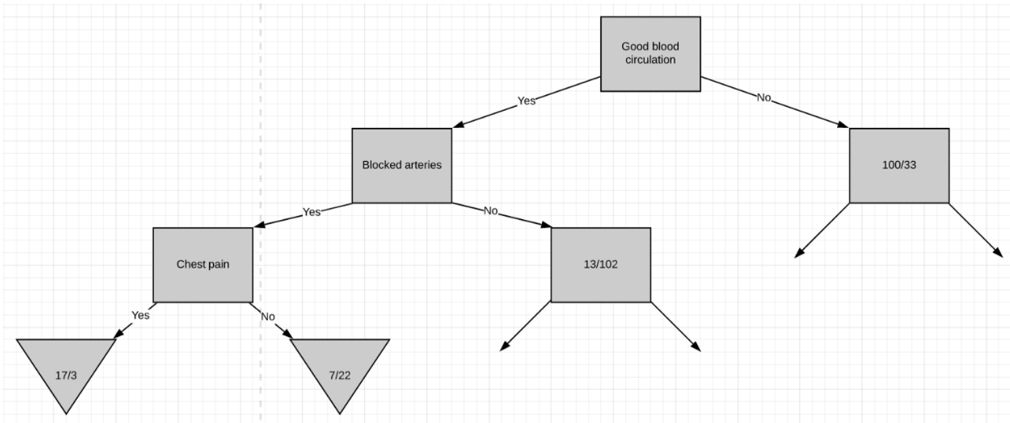
CART example

Slide 15
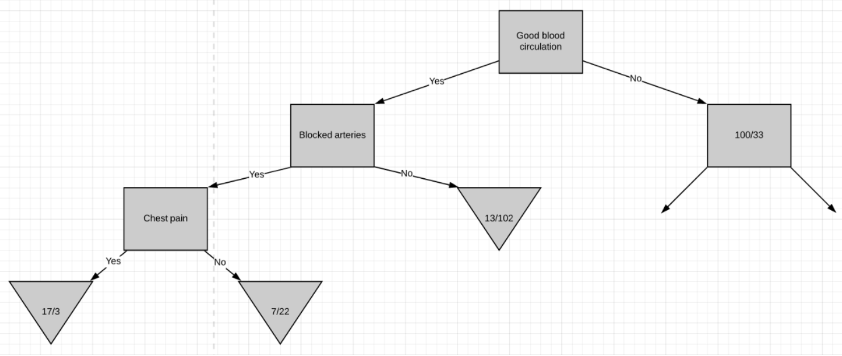
CART example
Gini impurity of parent node was lower – convert into leaf node

Slide 16
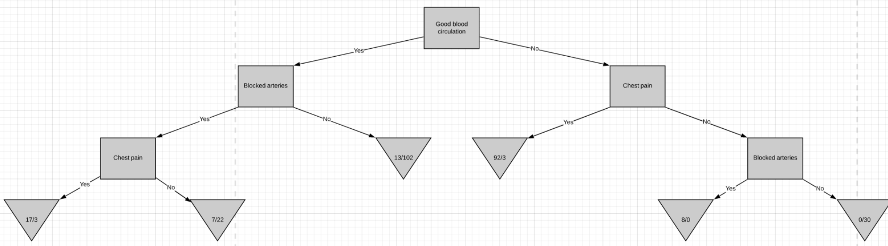
CART example – Complete tree

Slide 17
CART summary
Steps to build Decision Tree with CART:
Calculate the Gini impurity scores.
If the node itself has the lowest impurity score → no point in separating the patients anymore, convert to a leaf node.
If separating the data results in purity improvement → pick the separation with the lowest impurity value.
Greedy algorithm – optimal solution is not guaranteed
Finding optimal tree is an NP-complete problem → intractable even for small training sets
Prediction complexity → O(log₂(m))
Training complexity → O(n x m log₂(m))

Slide 18
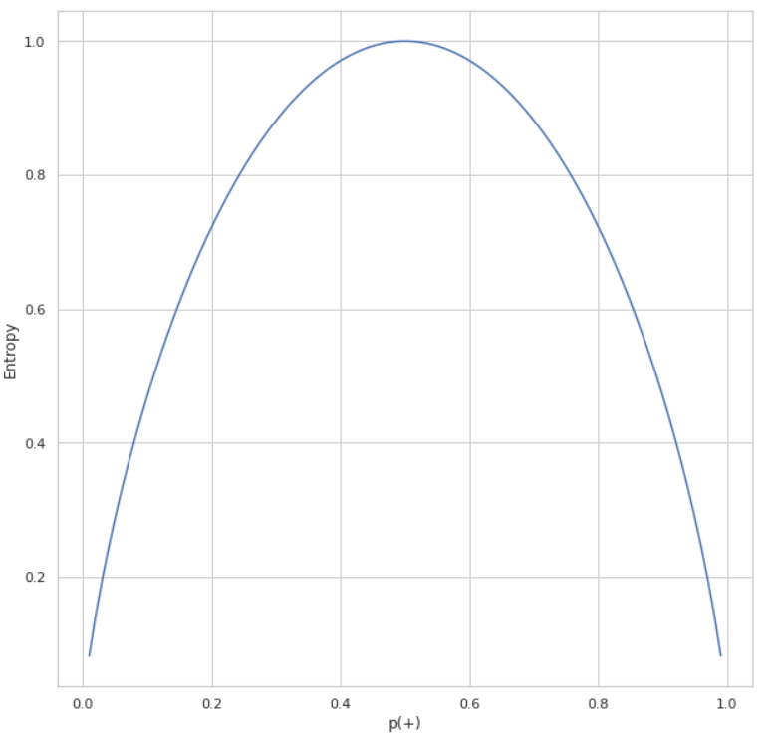
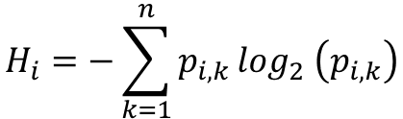
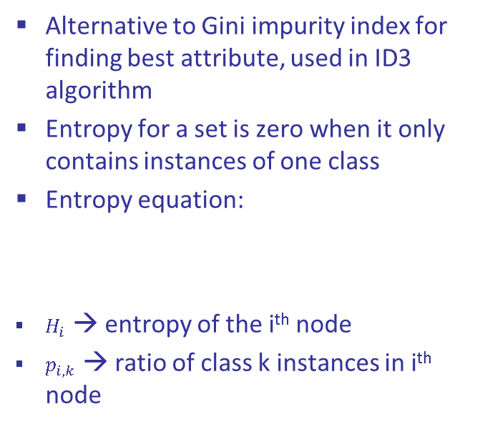
Entropy
Alternative to Gini impurity index for finding best attribute, used in ID3 algorithm
Entropy for a set is zero when it only contains instances of one class
Entropy equation:
$H_{i}$ → entropy of the i^{th} node
$p_{i,k}$ → ratio of class k instances in i^{th} node
$$H_{i}=−\sum_{k=1}^{n}{p_{i,k}}\log_{2} \left(p_{i,k}\right)$$
Gini → faster to compute, but isolates most frequent class in own branch
Entropy → More balanced trees

Slide 19
Regularization
DT makes few assumptions about training data, and if left unconstrained, it will overfit to the training data
Nonparametric model → number of parameters not determined prior to training, so model structure can stick closely to the data
Use regularization hyperparameters to reduce risk of overfitting
max_depth → maximum depth of tree
min_samples_split → min number of samples a node must have before it can be split
min_samples_leaf → min number of samples a leaf node must have
Limit overfitting by pruning – deleting unnecessary nodes either before or after training
pre-pruning: stop growing the tree when data split is insignificant or too few instances
post-pruning: remove branches from a fully grown tree and evaluate on validation data

Slide 20
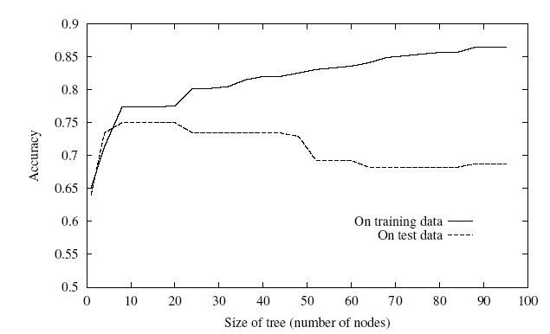
Decision Trees: Pros and Cons
Pros:
simple to understand and interpret (white box model)
little data preparation and little computation needed
indicates which attributes are most important for classification
Cons:
not guaranteed to produce an optimal decision tree
performs poorly with many classes and small dataset
over-complex trees do not generalize well from the training data (overfitting)

